Slide 1

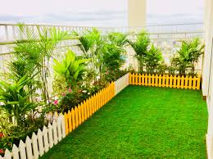
SMART
GARDEN
BY:-
MAYANK SAINI
RAJAT MATHUR
AYUSHMANN SHARMA

Slide 2
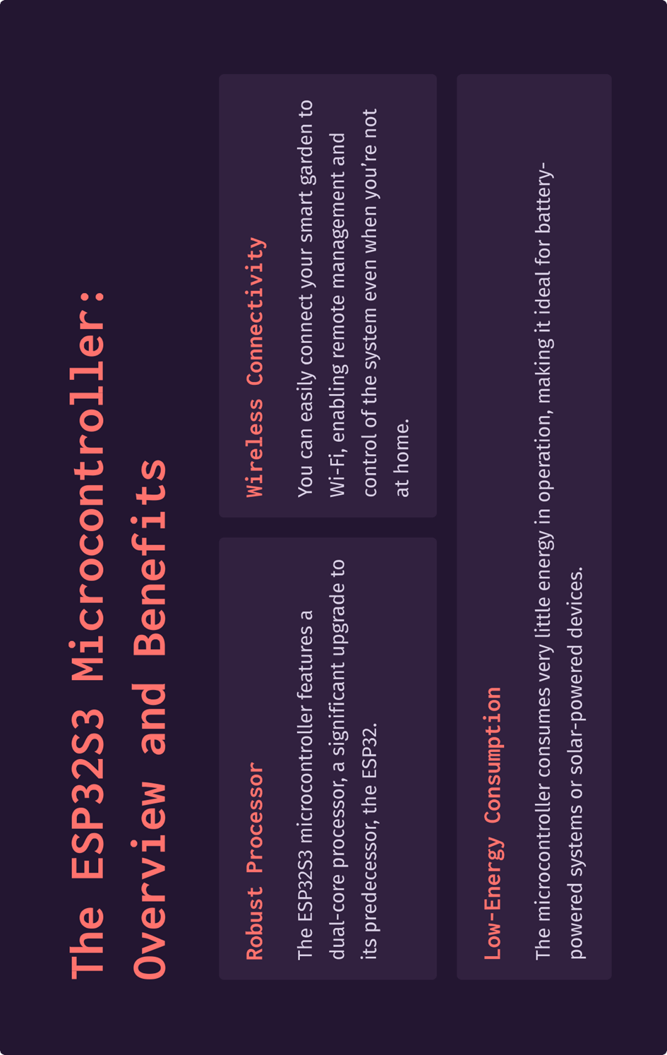

Slide 3
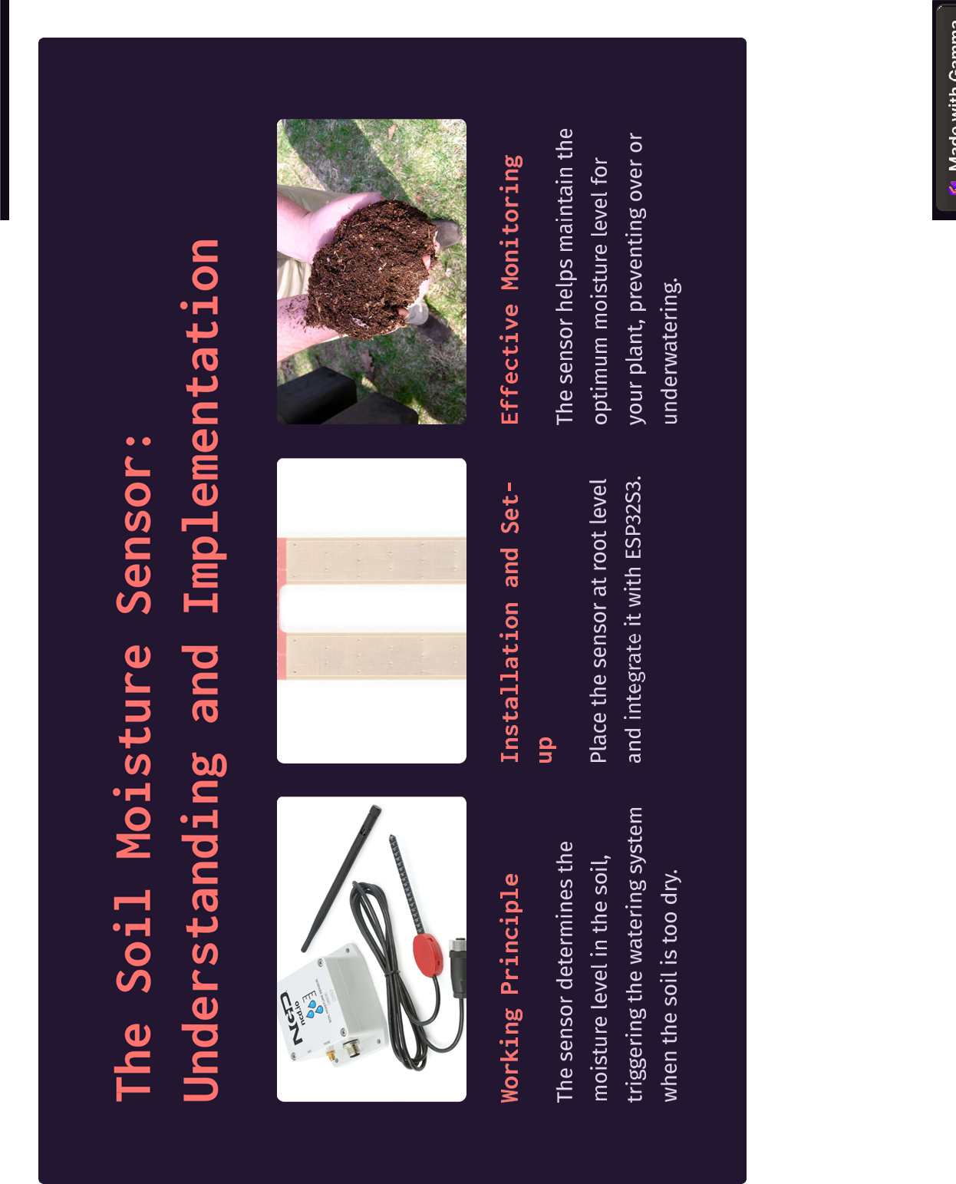
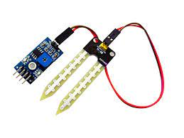

Slide 4
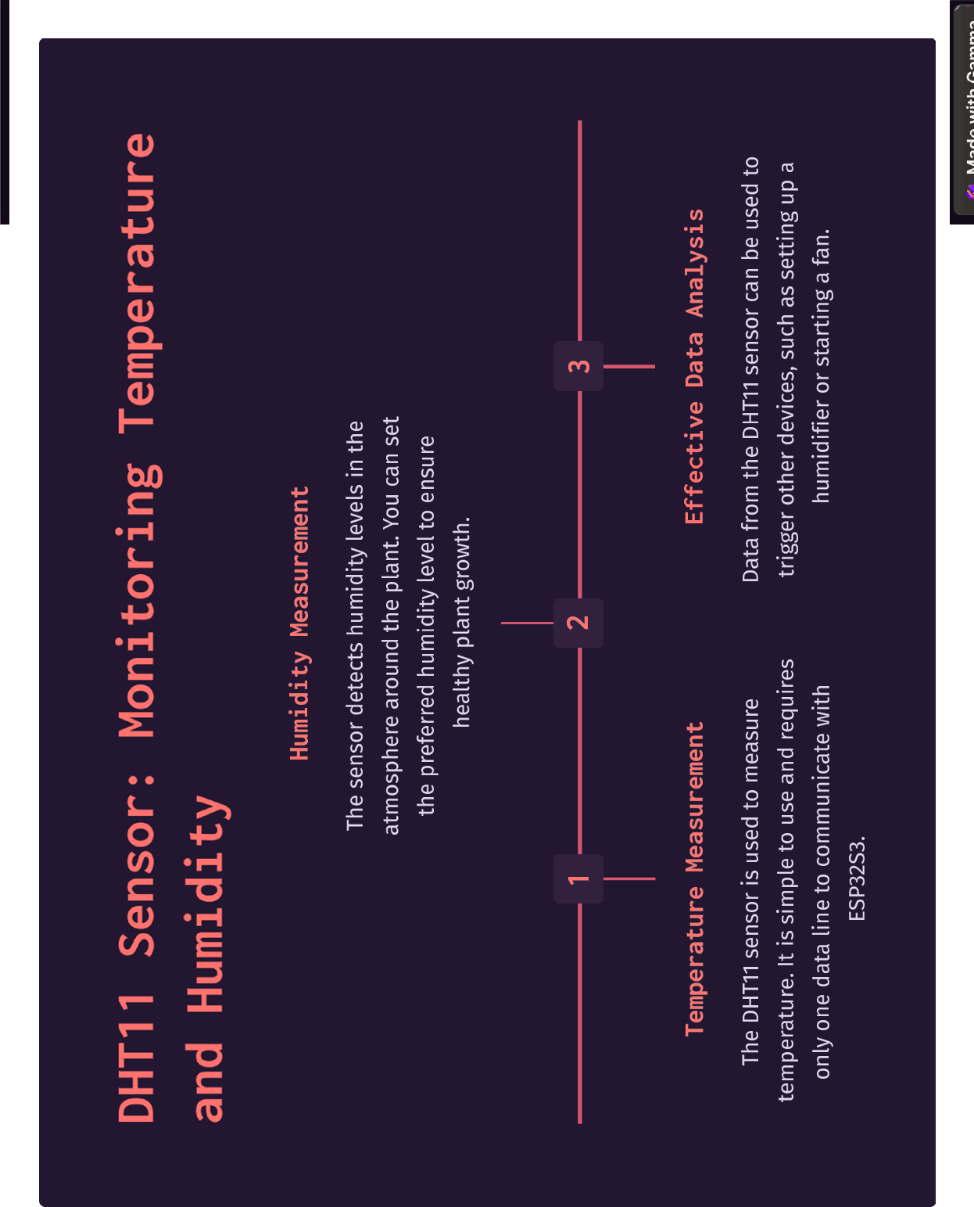

Slide 5
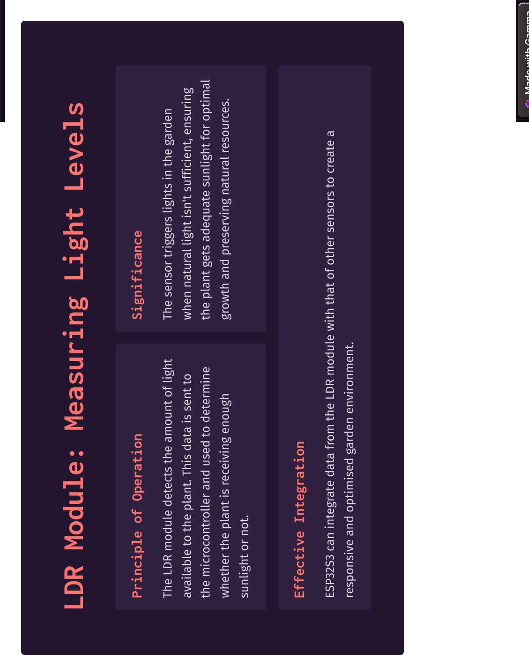

Slide 6
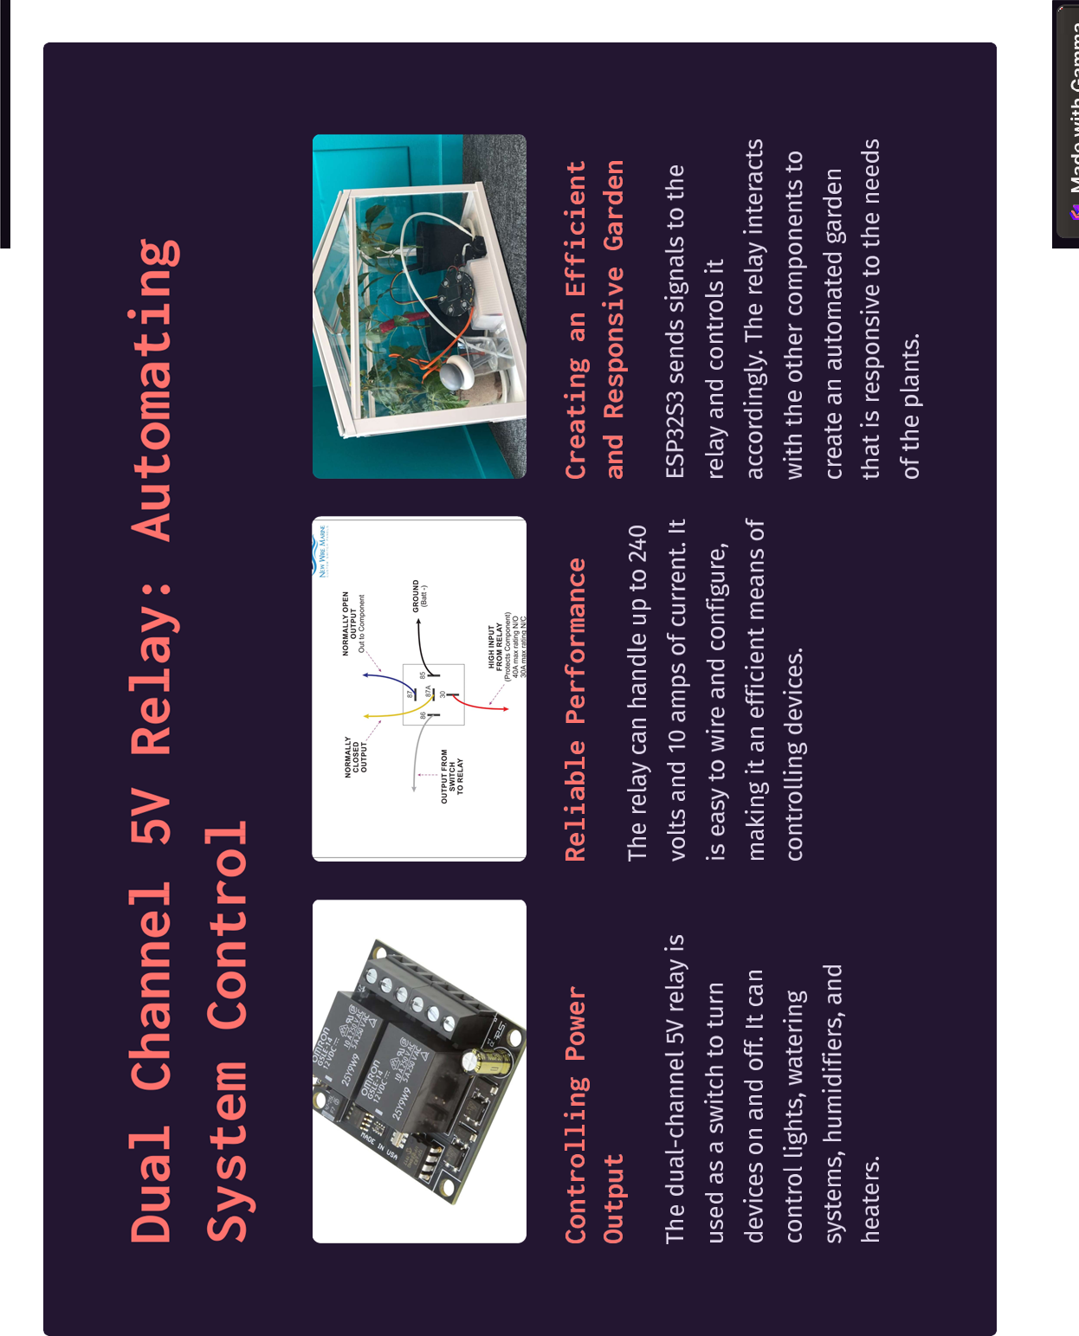

Slide 7
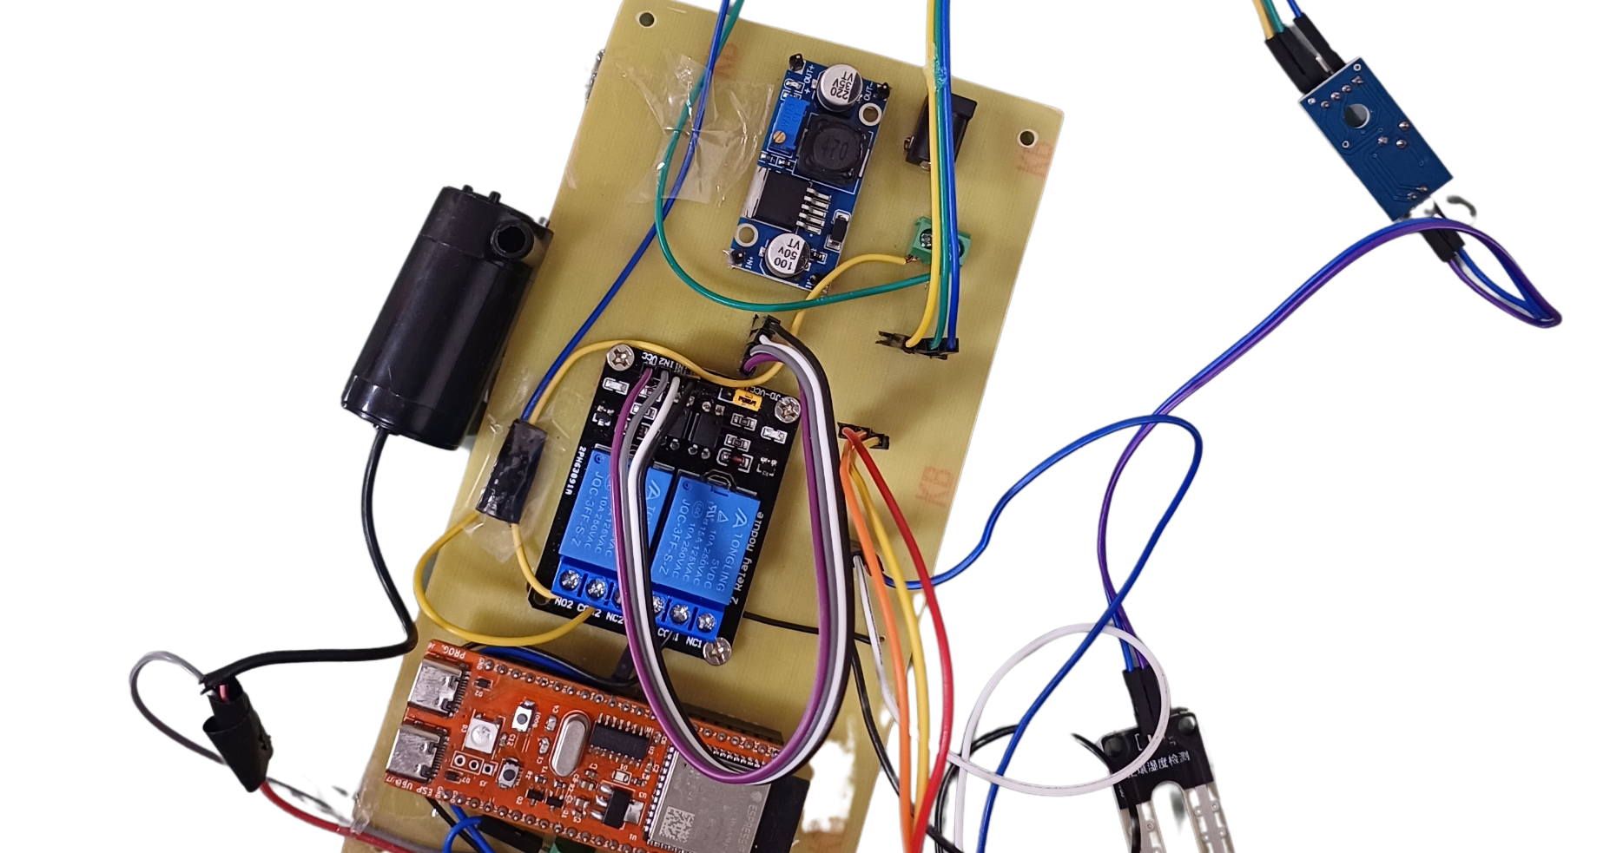
1. ESP32-S3: This acts as the brain of the system, responsible for collecting data from the various sensors, processing it, and controlling the other components. It connects to the Wi-Fi network to communicate with a mobile app or a web interface.
2. DHT11: The DHT11 sensor measures temperature and humidity. It provides real-time data about the environmental conditions in the garden.
3. LDR (Light Dependent Resistor): The LDR senses the light intensity in the garden. This helps the system understand whether it's day or night and adjust actions accordingly, such as turning on the LED at night or adjusting watering frequency.
4. Soil Moisture Sensor: This sensor measures the moisture level in the soil. It helps in determining when to water the plants based on their specific needs.
5. 5V Relay: The relay is used to control high-power devices like the 5V DC pump. It can be used to turn on/off the water pump based on soil moisture levels.
6. LED: The LED can be used for various purposes, such as providing light at night using the LDR data or indicating system status.
WORKIng

Slide 8
7. 5V DC Pump: This pump is used to deliver water to the plants. It can be controlled through the relay based on the soil moisture readings.
8. Buck Converter: The buck converter helps regulate the voltage supplied to various components, ensuring they receive a stable and appropriate voltage.
The workflow might look like this:
- The ESP32-S3 collects data from the DHT11, LDR, and soil moisture sensor.
- It analyzes the data and makes decisions, such as turning on the pump if soil moisture is low or adjusting LED brightness based on light levels.
- The ESP32-S3 can communicate the system's status to a user through a mobile app or a web interface.
- Users can also send commands to the ESP32-S3 to control the components manually.
- The 5V relay is controlled by the ESP32-S3 to turn the water pump on/off as needed.
- The buck converter ensures that the components receive a stable power supply.
Overall, the smart garden system enables automation and remote control, helping to create an optimal environment for plant growth while conserving resources like water and energy.

Slide 9
Benefits
1. Improved Plant Growth and Health.
2. Smart Garden ensures your plants are getting the correct amount of water, light, temperature, and humidity, leading to optimal plant growth results.
3. Saves Time and Water
4. The automatic watering system saves time and water usage, making it an eco-friendly option for garden enthusiasts.
5. Easy to Use and Maintain
6. Smart Garden requires no special maintenance or gardening skills. Just install it and enjoy a smart way of gardening.
7. Sustainable and Eco-friendly Option
8. Smart Garden is not only good for your plant's health but also for the planet. Save water and electricity while growing your own garden.

Slide 10
CONCLUSION
Revolutionary Technology
Smart Garden promises to introduce a new era of sustainable gardening with its revolutionary technology.
Easy and Convenient
It takes care of plants so that busy gardeners can reap the rewards of fresh produce without too much hassle.
Enjoy the Self-Sustainability
Reduce carbon footprint, save money, and enjoy fresh herbs and veggies grown in your Smart Garden.

